Slide 1
GIS and RS for Forest Resource Assessment
Kefyalew Sahle Hawassa University
Wondo Genet College of Forestry and Natural Resources
GIS Department

Slide 2
Unit 2. Information requirements for forest resources management

Slide 3
Topic to be covered are
Forest boundary
Forest compartment
Forest types / stratification
Forest site characteristics (physical)
Forest owners
Forest inventory summary
Forest cover change
Forest biomass
Forest damage

Slide 4
Overview
What information should be included in model forest management plan?

Slide 5
Overview What information should be included in model forest management plan?
A forest management plan defines the planned forestry activities, specifying objectives, actions and control arrangements in a forest area.
Examples of forest activities are forest inventory, yield calculation, harvesting, silviculture, protection and monitoring.
The required information depends on the activities types

Slide 6
Ideal Forest Resources Information Requirements (Source FAO)
Graphical Information Concerning Forest Land
- topographic maps | - cadastral maps (the forest boundary)
- management maps, including boundaries
- aerial photographs | - satellite imagery
- geographic information system data
2. Legal Information
- rights and privileges | - land tenure

Slide 7
Ideal Forest Resources Information Requirements (Source FAO)
3. Environmental Information
- geology | - soils
- biological diversity | - wildlife
- meteorology | - hydrology and watersheds
- forest ecology | - wood (log) resources
- forest growth and yields | - silviculture
- non-wood resources | - pests and diseases
- forest use & management history | - amenity and scenery

Slide 8
Ideal Forest Resources Information Requirements (Source FAO)
4. Social Information
- population and location | - community structure
- social relationships with forests | - recreation interest or potential
5. Economic Information
- wood prices | - wood markets
- taxation issues | - costs

Slide 9
List of the common information required in forestry are related to
Forest boundary
Forest compartment
Forest types / stratification
Forest site characteristics (climate and physical)
Forest owners
Forest inventory summary
Forest cover change
Forest biomass (carbon stock)
Forest damage
Forest use / services

Slide 10
Mapping requirements
Detailed mapping requirements for planned forest management will depend upon the goal and objectives for each forest management unit, determined through the review outlined in the previous section.
As a general guide, the primary map types to be purchased, or drawn if they do not exist, for planning sustainable management for wood production should include the following:

Slide 11
Essential Maps
Topographic map, showing primary geographic features, including contours; 1:50,000 or 1:25,000.
Land use planning map, showing the forest management unit together with settlement, agriculture and other land uses; 1:50,000 or 1:25,000.
Forest zoning map, showing zones for watershed protection, wood production, specific non-wood products, biological diversity conservation, recreation (or amenity) and any other primary forest zones; 1: 50,000 or 1:25,000. This map should be drawn as a part of the planning process, especially to determine the net productive area for wood production.

Slide 12
Essential Maps
Strategic planning forest harvesting map (felling blocks or felling series/compartments/roading); 1:50,000 or 1:10,000.
Tactical planning forest harvesting map (felling blocks/topography); 1:10,000, 1:5,000 or 1:2,000. This map should be drawn as a part of the planning process.
Reconnaissance forest map of merchantable tree species above a minimum dbh, e.g. > 50cm dbh, based on a low intensity forest reconnaissance; 1:50,000 or 1:100,000. This map, or maps, should be drawn progressively as a management plan is implemented.

Slide 13
Essential Maps
Forest inventory map (for continuous forest inventory), showing sampling strata/blocks and PSP positions; 1:50,000 or 1:25,000. This map should be drawn as a part of the planning process.
Tree position/tree species/topographic maps, overlaid with road map, compiled through 100% pre-harvest inventory of each compartment; 1:10,000 or less. This is a series of maps that should be drawn regularly for compartments as a management plan is implemented.

Slide 14
Desirable Maps
Cadastral map, showing legal ownership of land; 1:50,000.
Geology map; 1:100,000, or less.
Soils map; 1:50,000, or less.
Contour map; 1:5,000 or 1:10,000.

Slide 15
Other maps examples
The previously mentioned maps need not be the only map types for forest management and it is important that a forest manager should ask questions about mapping needs for each specific management situation.

Slide 16
Other maps examples: what and why?
What other map types are needed that will assist a forest manager in implementing planned management objectives?
Is a rainfall map necessary? Why?
Would maps showing the location or distribution of specific, uncommon or endangered plants or animals be helpful? What scale should such maps be?
Will maps showing the location of villages, areas where traditional food crops, medicinal plants or other products are gathered be managerially helpful? What is the most appropriate scale?
Will maps showing localities having scenic, recreational or ecotourism value be helpful? Why?

Slide 17
Stages in the review of maps for practical forest management
Stage One: To identify and acquire published base maps of a forest area to be managed showing physical features, including settlements, villages, roads and other infrastructure, rivers and coastlines, contours, geology, soils, land uses, forests and agricultural vegetation type boundaries.
Reports or notes which might accompany the maps should also be acquired.

Slide 18
Stages in the review of maps for practical forest management
Stage Two: To review the maps that have been collected. The questions to be answered could include:
Is the map coverage, map scales and physical detail on maps adequate for planning, zoning or operational purposes, such as recognition of forest boundaries, definition of major physical features (rivers, ridges) and definition of contours? Are they up-to-date?
Which new maps are required for forest zoning (protection, production and other broad zones), for forest stratification and inventory, roading, for forest protection, community development and other purposes which might be related to specific forest management objectives? What map scales should be used?
Where and through whom can relevant new maps showing the detail required for management purposes be prepared or acquired? What are the priorities in map preparation?
How long will acquisition of new maps take? What are the requirements and estimated cost?

Slide 19
Forest boundary
What is forest?
Forest boundary ?

Slide 20
What is forest according to the current definition of Ethiopia?
In February 2015 Ethiopia adopted a new forest definition (MEF 2015) as follows: 'Land spanning more than 0.5 ha covered by trees (including bamboo) (with a minimum width of 20m or not more than two‐thirds of its length) attaining a height of more than 2m and a canopy cover of more than 20% or trees with the potential to reach these thresholds in situ in due course (Minutes of Forest sector management, MEFCC, Feb. 2015).
Ethiopia is in the process of approving this as its national legal definition. This forest definition differs from the definition used for international reporting to the Global Forest Resources Assessment (FRA) and from the forest definition used in the NFI which both applied the FAO forest definition with the thresholds of 10% canopy cover, a 0.5 ha area and a 5 m height.

Slide 21
What is forest according to FAO?
According to the FAO, Forest is defined as: “land spanning more than 0.5 hectares with trees higher than. 5 meters and a canopy cover of more than 10 percent, or trees able to reach these thresholds in situ. It. does not include land that is predominantly under agricultural or urban land use”.

Slide 22
Forest boundaries
Definition and maintenance of forest boundaries
Selection of Forest Management Unit Boundaries
What is forest compartment?

Slide 23
Permanent definition of forest boundaries
A basic principle of forest management is clear and permanent definition of forest boundaries - irrespective of land ownership and tenure -linked to permanent marking, surveying and mapping of boundaries.
Permanent definition and subsequent surveying of boundaries are essential steps in defining and mapping a permanent forest estate.
They also contribute towards achieving effective protection of a forest from degradation or loss.

Slide 24
Permanent definition of forest boundaries
It is not possible, in practice, to define the area of a forest where planned sustainable management is proposed, nor to derive an annual allowable harvest in the absence of permanently defined, surveyed and mapped forest boundaries.
The boundary of a forest should be included in the cadastral map.

Slide 25
Forest boundaries
Definition and maintenance of forest boundaries
Selection of Forest Management Unit Boundaries
What is forest compartment?

Slide 26
Selection of Forest Management Unit Boundaries:
Wherever it is practicable to do so, natural geographic features should be selected to define the boundaries of a forest management unit.
These include rivers, streams, shorelines, ridges and spurs.
Permanent and clearly defined roads, railways and tracks may also be used.
On flat country not having clearly recognisable natural features boundaries can be defined using straight lines that have a N-S, E-W orientation to enable them to be shown as true or magnetic coordinates on maps.
The number of comers on straight line boundaries should be kept to a minimum.

Slide 27
Demarcation and Maintenance of External Forest Boundaries
External boundaries should be kept clear of bushy vegetation for a width of two metres in order that neighbours may easily recognise a boundary and to allow it to be patrolled.
Trees located on a boundary should not be removed. Cost sharing between forest neighbours in the maintenance of common boundaries is desirable. This approach confirms agreement on the line of a common boundary and is cost-efficient.
Boundaries should be defined and marked using beacons which may be durable wooden poles or stone or concrete pillars painted using two contrasting colours, such as broad red and white bands.

Slide 28
Definition and maintenance of forest boundaries: Patrolling
Patrolling is essential and should be undertaken often in heavily populated areas or where the risk of boundary transgression is considered to be high.
Forest guards should be accountable to a senior officer or director.
Aerial inspection and remote sensing imagery can be helpful for checking boundaries but these methods are most useful after boundaries are known on the ground.
Notices should be erected on high-use parts of a boundary.

Slide 29
Forest boundaries
Definition and maintenance of forest boundaries
Selection of Forest Management Unit Boundaries
What is forest compartment?

Slide 30
What is forest compartment?
Forest compartment is a section of forest with homogeneous growth conditions and tree species. It may also be called stand compartment or stand. The size of compartments varies. Compartments are marked in forestry maps, and forest management plans are made according to their growing conditions.
Forest compartment is the smallest unit of management. Management operations are done at the compartment level and history of each compartment is periodically maintained.
A compartment is a permanent, geographically recognisable unit of forest land forming the basis for planning, prescription, implementation, monitoring and recording of forest operations. To the extent that it is practicable, areas of forest that are to be managed for different purposes, or have clearly different functions or values, should be placed in separately defined compartments.

Slide 31
Practical guidelines for defining forest compartments are:
Wherever practicable:
Boundaries should be geographically recognisable, such as rivers, streams, ridges and gullies. Permanent roads and trails may also be used. Boundaries should be recorded on all forest management maps.
Compartments should as far as possible comprise uniform forest types and be physically recognisable on the ground.
Numbering should be sequential, usually commencing at a forest headquarters. Compartment numbers should not be changed.
Compartments should not be so large that sub-division into numerous sub-compartments is required in order to achieve effective implementation of forest operations. Sub-compartmentation should be minimised. Flexibility is required in determining compartment size; a practical size range for many management situations is between 100 ha and 500 ha, depending upon the physical features of the forest and land.

Slide 32
Compartment Records
Compartment records may either be constructed and maintained manually in a register, or on a personal computer using database software. Each record should have four main components, as follows:
A summary of site conditions (soils, slopes, rainfall),
Pre-harvest inventory data (species, tree numbers and volumes expressed by stem diameter classes),
Dates and details of harvesting and silvicultural operations (site preparation for planting, weeding/slashing, pruning, selective harvesting, shelterwood cutting, thinning, climber cutting, enrichment planting, release weeding),
Post-harvest inventory data (poles, saplings, seedlings, nucleus trees).

Slide 33
Manually maintained compartment history
An example of a manually maintained compartment history record is shown in the FAO guideline “A Manually Maintained Compartment History Record”

Slide 35
Forest types / stratification
Forest inventories may be carried out at country, regional, or global level.
The methodologies used to develop the inventories vary widely.
Even at the country level, a full coverage of all the forest area is seldom carried out. Some parameters to be estimated entail destructive sampling to generate mean values that are used as representative values for certain forest components.
In general, two approaches are used (either jointly or separately) in forest inventories: (1) remotely sensed data (aerial photographs, satellite imagery), and (2) statistical sampling techniques. Although some information can be provided via remote sensing, the main share of data is usually obtained through field measurements, hence the need to rely on sampling techniques.

Slide 36
Forest types / stratification
Aerial photographs and satellite imagery may be useful to stratify the forest area into vegetation types, or even tree species, depending on the scale of the aerial photographs or the spatial resolution of the sensor on board the satellite.
Through stratification, a number of strata containing relatively homogenous elements is defined.
Then sampling can be applied in each stratum, ensuring that all the classes of interest (vegetation types or tree species, for instance) are included. Multistage stratification can also be applied. First, the broad classes of forest types are stratified, and then each stratum is further stratified according to tree species, height, age, wood volume, or productivity, for instance.

Slide 37
Forest types / stratification
One common practice for stratifying the forest area according to different forest types (broad categories) is to integrate fine spatial resolution satellite data (around 30 meters) with available national vegetation maps in a geographical information system (GIS).
Satellite data can be used to update the vegetation maps and, on the other hand, the existing vegetation maps may be useful in providing the spectral characteristics of broad vegetation types, improving the thematic classification (digital or based on visual analysis).

Slide 38
Forest can be classified / stratified based on
different criteria/factors:
origin of the forest (manmade / natural),
natural vegetation type,
biome,
density,
species,
ownership,
use,
location, etc.

Slide 39
Ethiopian vegetation types
A new map of the potential vegetation types of Ethiopia has been produced on the scale of 1:2,000,000.
It is published as an atlas with 29 map plates.
The map shows the distribution of twelve potential vegetation types that can be mapped using environmental parameters and GIS methodology.

Slide 40
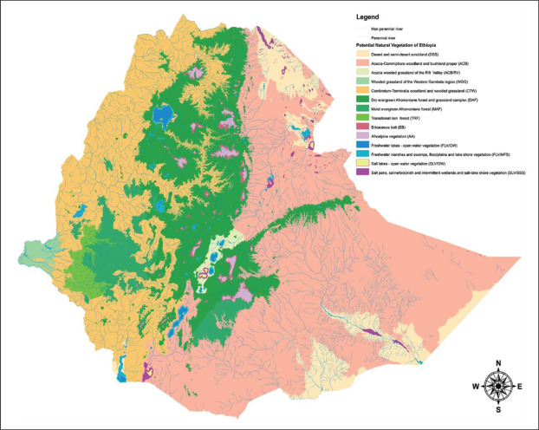
Map of the vegetation types of Ethiopia

Slide 41
The types and subtypes are
Desert and semi-desert scrubland.
Acacia-Commiphora woodland and bushland (with the subtypes
(2a) Acacia-Commiphora woodland and bushland proper and
(2b) Acacia wooded grassland if the Rift Valley).
Wooded grassland if the western Gambela region.
Combretum-Terminalia woodland and wooded grassland.

Slide 42
The types and subtypes are
Dry evergreen Afromontane forest and grassland complex (with the subtypes
(5a) Undifferentiated Afromontane forest,
(5b) Dry single-dominant Afromontane forest if the Ethiopian highlands,
(5c) Afromontane woodland, wooded grassland and grassland,
(5d) Transition between Afromontane vegetation and Acacia-Commiphora bushland on the Eastern escarpment).

Slide 43
The types and subtypes are
Moist evergreen Afromontane forest (with the subtypes
(6a) Primary or mature secondary moist evergreen Afromontane forest, and
(6b) Edges if moist evergreen Afromontane forest, bushland, woodland, and wooded grassland.
Transitional rainforest.
Ericaceous belt.
Afroalpine belt.

Slide 44
The types and subtypes are
Riverine vegetation.
Fresh-water lakes, etc. (with the subtypes
(11a) Fresh-water lake vegetation (open water) and
(11b) Freshwater marshes and swamps, floodplains, and lakeshore vegetation).
Salt lakes, etc. (with the subtypes
(12a) Salt lake vegetation (open-water) and
(12b) Salt pans, saline/brackish and intermittent wetlands, and salt-lake shore vegetation).

Slide 45
Biomes of Ethiopia
The potential vegetation map has been also used as an input to create the strata map that is the base layer used to design the national Forest and Landscape Inventory of Ethiopia.
As the Forest and Landscape Inventory is not focused only on forest strata, during 2015 a new aggregation map was proposed to better represent the reliable carbon stock estimates.
Using the 12 vegetation types as input, these have been aggregated into 5 biomes following expert judgment by Ethiopian botanical scientists.
Based on their knowledge of the vegetation types and their physiology they have suggested the following aggregation into four biomes with expected homogenous carbon contents

Slide 46
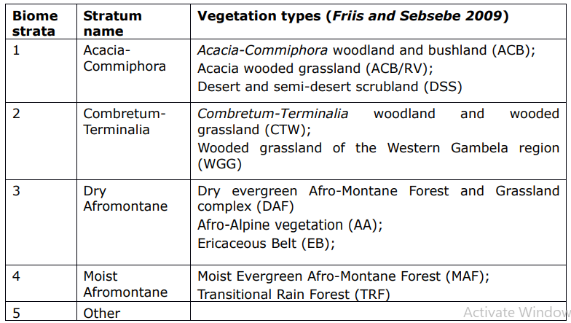
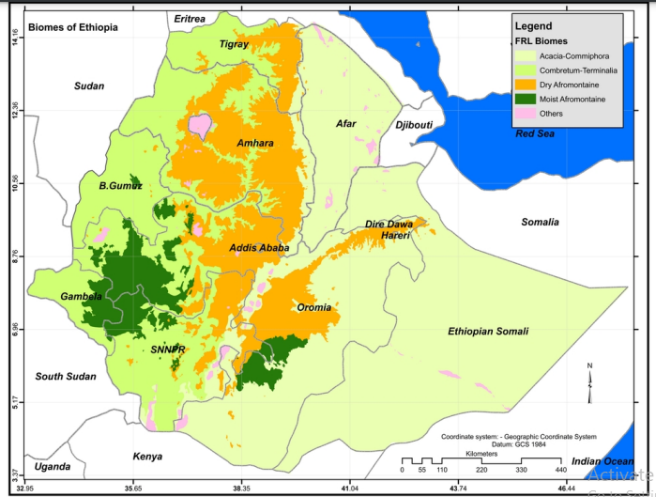
This new stratification has been adopted to estimate the carbon content for the FRL purposes.
Notes:
Acacia-commiphora
Combretum-Terminalia
Dry Afromontane
Moist Afromontane
Other

Slide 48
Zoning
Demarcation and maintenance of internal forest boundaries: The boundaries of biological, wildlife, watershed, forest community or other reserves should be as clearly defined as are external boundaries. Roads, cut lines, pillars, painted standing trees and poles should be used to define internal boundaries.
Internal compartment boundaries should be surveyed and mapped. Notices should be erected showing boundaries of watershed and other reserves where wood harvesting is not allowed.
Each specific area of forest that is a separate zone should be placed in a separate sub-compartment, or a compartment if the zone occupies a whole compartment. Value judgements that are formed in the field and will form the basis of forest zones should be supported by inventory data.
Forest zoning may be assisted through the use of a GIS that enables computer generated maps of zones to be drawn.

Slide 49
Common descriptions of the primary forest zones are
Each may be sub-divided, depending upon local needs, into more specific zones:
Wood Production Zone - where wood production is not bound by other forest values.
Watershed Zone - where soil conservation and watershed values are dominant.
Wildlife Conservation Zone - where forest forms an important habitat for specific animals.
Biological Diversity Conservation Zone - where forest is ecologically important because it contains unusual and possibly endangered plants and/or animals.
Amenity (or Scenic) Zone - where forest has landscape values in relation to highways, railways or towns where the forest is frequently viewed by people.
Local Community Zone - where areas of forest are predominantly of value to the physical and spiritual well-being of local forest dependent communities. It can include burial grounds.
Recreation Zone - where forest is used for public recreation, such as picnic, camping and trekking areas.
Scientific Studies Zone - where forest is used, or might be used, for specific forest research studies. It may be linked to wildlife, biological diversity and watershed conservation zones.

Slide 50
Important questions that should be asked when undertaking zoning
What are the primary values, or characteristics, of each specific area of forest? Can the values identified be clearly described and can they form the basis of a zone?
Can value judgements on possible zones be supported by good quality inventory and other technical data? What new data is necessary and how can it best be acquired?

Slide 51
Forest site characteristics (physical)
Many characteristics of the forest are affected by the physical environment in which they are found.
The major components of the physical environment that shape the forest include
landscape and soil type,
climate,
topography, and
water systems.

Slide 52
Climate
Variations in the physical environment, such as temperature, light, and precipitation, depend upon the time of year, time of day, topography, and latitude.
These variations are commonly called climate, which can be expressed on a large areal scale (e.g., the tropical climate) or on a very local scale (e.g., the climate of a forest), which we call microclimate.
All plant growth depends on the availability of water, which in forest ecosystems is provided primarily by precipitation, but can also be provided by access to groundwater or, in riparian forest communities, to stream water.
Forest canopies intercept some precipitation, and thus only 50-80% of rainfall reaches the forest floor, of which some of that evaporates before entering the soil. Of the precipitation that reaches the soil, approximately 50-80% will be transpired back into the atmosphere by the vegetation. Thus, forests serve as large water pumps between the soil and the atmosphere.

Slide 53
Soil
Trees are rooted in soil, which provides nutrients and water that support tree growth. The availability of nutrients and water are dependent on soil texture (sand, silt, loam, clay content), pH, cation exchange capacity, and water holding capacity, that are determined not only by soil texture but also by organic matter content, and porosity.
These properties are largely a function of the geology of a specific site, which is determined by the bedrock quality, weathered bedrock material, and organic matter incorporated into the weathered bedrock material.
Depending on the soil properties, more or less nutrients or water become available to the trees.

Slide 54
Topography
A key factor in maintaining heterogeneous forest landscapes is topography. Topographic features such as terrain relief, slope and curvature strongly influence local‐scale variation in soil chemistry, hydrology and microclimate.
As such, they directly constrain the conditions within which trees grow, driving environmental filtering, controlling species’ demographic rates, and ultimately shaping the structure and composition of forest patches.
For instance, on ridges and steep slopes, strong competition for nutrients and water favours species with life‐history traits geared towards maximising survival. By contrast, forests in alluvial valleys are moulded by fierce competition for light, and generally develop taller, vertically stratified canopies, while also maintaining higher productivity and turnover rates.
Slope determines the forest harvesting. Harvesting includes marking the trees to be removed (in selective cutting), felling and processing (conversion) of trees, and transportation of the wood from the felling site, or stump area, to a roadside storage site or a central processing yard (landing) in the forest.

Slide 55
Forest owners
Proclamation No. 1065/2018 is for the Forest Development, Conservation and Utilization Proclamation. Article 4 addresses the Forest Ownership in Ethiopia. According to this article, there shall be the following types of forest ownership፡
Private forest or;
Community forest or
Association forest
State forest.

Slide 56
Forest inventory
Forest inventory data are the primary information source for forest management.
Forest inventories are undertaken to provide a survey of the location, composition, and distribution of the forest resource and their relative amounts over a given area.
Forest inventories are required to derive the information for resource evaluation enabling management decisions at a variety of levels, such as harvest plans through to the development of different level strategies.

Slide 57
Forest cover change
Roughly speaking, change detection methods in remote sensing and GIS are based on finding discrepancies in two satellite images before and after a certain event.
Change detection algorithms for GIS compare the spatial representation of two points in time and measure differences in the variables of interest.

